Slide 1
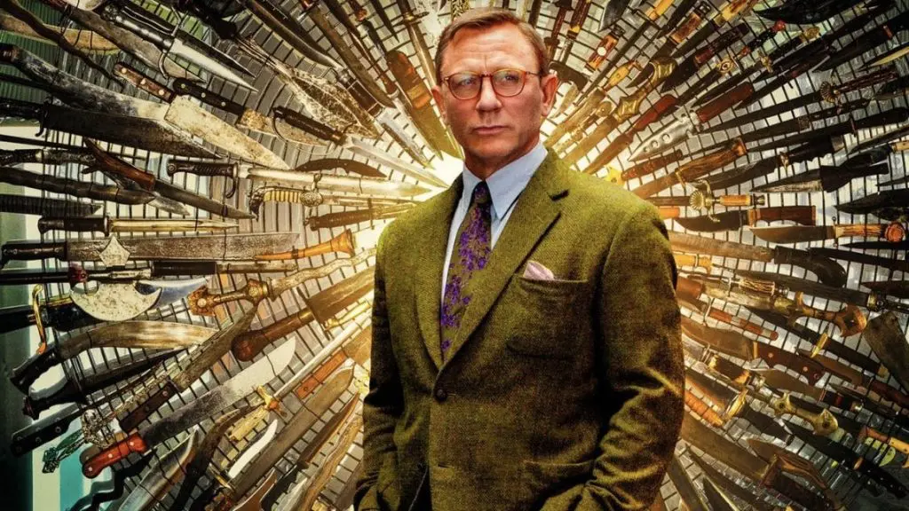
Our PARADIGM

Slide 2
Contents:
Our Teachers, Our Philosophy, Our Basic Latin Phrase, Our main Experience (reference to Tactics), Our main Touch, Our most precious Resources, Our First Substance, Our Creed, What we Seek/Find, Our Logic, Our main Initial Affirmation, Our fundamental Forces, Our Passion, Our main Pillars, Our Style and Value, Our precious Fruit/Seed, Our Key to Integrity, Our Response, Our Movement Direction, Our General Ready Stance, Our main Heart Movement, Our beloved Equations, Our basic Movements of Mind, Our Future, Our Transformation, Our Reality, Our principal Tool, Our main Moving Form, Our main Thinking/Contemplation, Our beloved Sequence, Our basic Theories, Our Notion of Space and Time, Our Mindset, The Matrix of our Multidimensional (Complex) Spacetime in the Multiverse, Our Individuation, The Way We Make Choice/Decision, Our Way of Being/Doing, Our Language, Our Quantum Language, Our Rhythm, Our preferable Symphony, Our main Body Movements, Who we are

